Slide 1
Portland – A Scalable Fault-Tolerant Layer 2 Data Center Network Fabric
Sowmya Satyavada
Shivani Patnani
Rutu Bhatt
Neha Mundada

Slide 2
AGENDA
INTRODUCTION
DESIGN
IMPLEMENTATION
RESULT
CONCLUSION

Slide 3
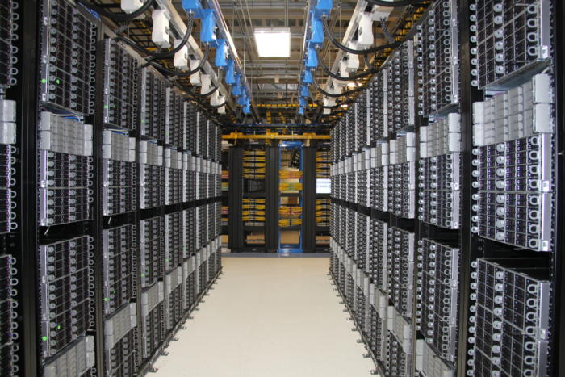
INTRODUCTION The Motivation For This Study
Problem : Identify a scalable , easily manageable DCN fabric.
Why do we need for a new scalable DCN Fabric?
Notes:
This paper evaluates and considers the requirements for a scalable, easily manageable data center network fabric.
As you can see in the pic which is an example for datacenter with 1000s of machines hosting millions of VMS
We have so many existing data center networks then why do we need a new data centers network?
The Current and future trends are pointing to mega single site data centers that host millions of virtual machines. Consider a data center with 100k machines and each machine hosting 32 VMs. This translates to 3 million ip and mac addresses in the Data center. Assuming a network switch per 25 physical hosts -> this translates to 8000 switches in that dc which makes it impossible to manage
Existing layer 2 and layer 3 network protocols face some combination of limitations in such a large scale setting: lack of scalability, difficult management, inflexible communication, or limited support for virtual machine migration which is sometimes essence of having the large scale data centers.
To some extent, these limitations may be inherent for Ethernet/IP style protocols when trying to support arbitrary topologies however fall short when applied to data centers.
Ideally data center admins would like a pluggable network fabric with minimal human intervention. Hence the motivation for this paper is to build a new fabric on existing layer 2 protocols to enhance scalability manageability, flexibility and fault tolerance.

Slide 4
Requirements for a Scalable DCN Fabric
R1:Any VM may migrate to any physical machine. Migrating VMs should not have to change their IP addresses as doing so will break pre-existing TCP connections and application-level state.
R2:An administrator should not need to configure any switch before deployment.
R1 and R2 require a single layer 2 fabric for the entire data center
Any end host should be able to efficiently communicate with any other end host in the data center along any of the available physical communication paths.
This requires MAC forwarding tables with potentially millions of entries, impractical with today’s switch hardware.
There should be no forwarding loops.
forwarding loops are possible during routing convergence.
Failures will be common at scale, so failure detection should be rapid and efficient. Existing unicast and multicast sessions should proceed unaffected to the extent allowed by underlying physical connectivity.
requires efficient routing protocols to notify topology change. Broadcast in this nature leads to congestion.
Notes:
So now that we have seen the current and future trends
We will see what are the req for futuristic DCN.
How does the current state of datacenter network fall short ?
These 2 require a single layer two fabric which is not feasible.
What does this require
Now that we know the current state of dcn are not able to satisfy all of these requirements
We can assume that the vision of a unified plug-and-play large-scale network fabric is unachievable, leaving data center network architects to adopt ad hoc partitioning and configuration to support large-scale deployments

Slide 5
PORTLAND
Ethernet compatible routing, forwarding, and address resolution protocols
enables switches to discover their position in the topology
Pseudo MAC (PMAC) addresses to all end hosts to encode their position in the topology.
PMAC addresses enable efficient, provably loop-free forwarding with small switch state
Notes:
Finally with Portland we like to present
In this paper, we present PortLand, a set of Ethernet compatible routing, forwarding, and address resolution protocols with the goal of meeting R1-R5 above.
As we have seen data centers are physically interconnected as a multi rooted tree
Using this observation, PortLand employs a lightweight protocol to enable switches to discover their position in the topology.
PortLand assigns internal Pseudo MAC (PMAC) addresses to all end hosts to encode their position in the topology . We will look at what is PMAC in detail later.
PMAC addresses enable efficient, provably loop-free forwarding with small switch state

Slide 6
Forwarding in DCN
Layer 3
Assigning IP addresses hosts hierarchically based on connected switch
Used standard intra domain routing protocol.
Large administrative overhead
Layer 2
Forwarding is based on MAC addresses
Less administrative overhead
Broadcast limitations ,Not scalable, low performance
middle ground
VLANs to allow a single logical Layer 2 fabric to cross multiple switch boundaries.
Feasible for smaller topologies
Lack flexibility and scalability for dynamically changing communication pattern.
Notes:
We will look at the concept of forwarding in layer 2 vs layer 3
Forwarding :
While VLANs allow a middle ground between layer 2 and layer 3 by providing a logical layer 2 across switch boundaries, VLANs lacks flexibility (as bandwidth resources to be explicitly assigned to each VLAN at each participating switch) and scalability (as each switch must maintain state for all hosts in each VLAN that they participate in).

Slide 7
DESIGN
Goal: To deliver scalable layer 2 routing, forwarding, and addressing for data center network environments.
Fabric Manager, Positional PMAC addresses, Proxy based ARP, Distributed Location Discovery, Provably Loop Free Forwarding and Fault Tolerant routing are used by Portland to achieve this goal.

Slide 8
Fabric Manager
Maintains soft state. Ex- Topology.
User Process running on a dedicated machine that assists with ARP, fault tolerance, multicast.
It maybe a redundantly connected host or it may run on a separate control network.
In Portland, amount of centralized knowledge is restricted because it maintains the soft state.
In deployment, Fabric Manager is expected to be replicated and the replica doesn’t have to be strictly consistent since there is no hard state here.

Slide 9
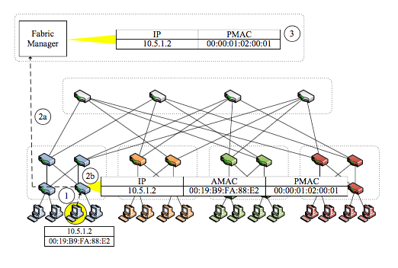
Positional pseudo MAC address (PMAC)
Assigns a unique PMAC ad- dress to each end host which encodes the location of the end host.
Portland Edge switches assign a 48-bit PMAC of the form pod.position.port.vmid to connected hosts.
Flow table entries are required to perform deterministic PMAC ↔ AMAC rewriting as directed by the switch software.
Pod – 16 bits
Position – 8 bits
Port – 8 bits
Vmid – 16 bits

Slide 10
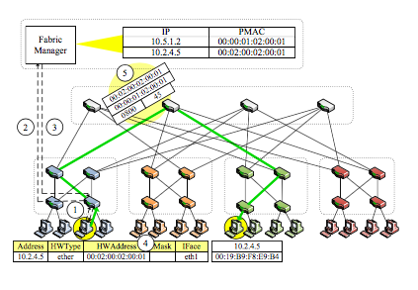
Proxy based ARP
An edge switch intercepts an ARP request for IP to MAC mapping and forwards this request to Fabric Manager. PMAC is returned if there is a valid entry in the PMAC table for the given IP address and an ARP reply is generated.
In case of failure in mapping, fabric manager has a mechanism to overcome the failure by transmitting a new ARP to add mapping details in the table.
Limitation: Any hosts communicating with the migrated VM will maintain that host’s previous PMAC in their ARP cache and will be unable to continue communication until their ARP cache entry times out.
Solution: The fabric manager forwards an invalidation message to the migrated VM’s previous switch that sets up a flow table entry to trap handling of packages. The switch software transmits a unicast gratuitous ARP back to any transmit- ting host to set the new PMAC address in that host’s ARP cache.

Slide 11
Distributed Location Discovery
PortLand switches use their position in the global topology to perform efficient forwarding and routing.
To explore the limits of Portland switch, a location discovery protocol (LDP) is used that requires no administrator configuration.
PortLand switches periodically send a Location Discovery Message (LDM) out all of their ports both, to set their positions and to monitor liveness in steady state.
Following details are contained in LDM: switch_id, pod, pos, level and dir.
The key insight behind LDP is that edge switches receive LDMs only on the ports connected to aggregation switches (end hosts do not generate LDMs).

Slide 12
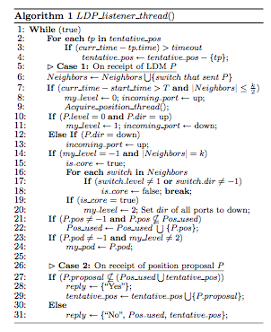
Distributed Location Discovery
Algorithm 1 presents the processing performed by each switch in response to LDMs.
Algorithm provides details like: Position, type of switch, type of port, level of core switches.

Slide 13
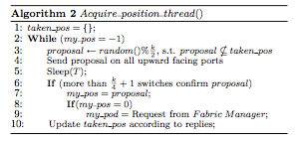
Distributed Location Discovery
Algorithm 2 is a function to acquire position used by Algorithm 1. Edge switches must acquire a unique position number in each pod in the range of 0..k −1.
Each switch proposes a randomly chosen number, If the proposal is verified by a majority of these switches as unused and not tentatively reserved, the proposal is finalized and this value will be included in future LDMs from the edge switch.
LDP leverages the fabric manager to assign unique pod numbers to all switches in the same pod

Slide 14
Distributed Location Discovery
Problem : Even in a data center environment, it may still be possible that two host facing ports inadvertently become bridged. or example, someone may inadvertently plug an Ethernet cable between two out- ward facing ports, introducing a loop.
Solution : If an uninitialized switch begins receiving LDMs from an edge switch on one of its ports, it must be an aggregation switch or there is an error condition. In an error condition, the switch disables the suspicious port and signals an administrator exception

Slide 15
Provably Loop Free Forwarding
Depending on the local positions of the switches the forwarding tables are created.
Core switches learn Pod number of the aggregation switches to forward the packets and Aggregation Switches learn the position number of all the Edge switches.
Load Balancing is done by the Flow hashing Technique.
This forwarding protocol used with an observation of up-down semantics.
First the Packets are sent to the aggregation or core switch and later to the destination.
Limitation
Packets are protected from transient loops and broadcast storms because once a packet travels down it is not possible for it to travel back up.
Detouring can be done to get back down but it is rare

Slide 16
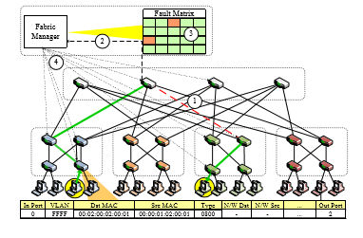
Fault tolerant Routing-Unicast
Routing protocol Concern:
Detecting switch and link failure/Recovery.
Failure Recovery Process:
If an LDM is not received , a switch assumes link failure.
Fabric Manager is informed by the detecting switch.
The Fault matrix is updated with new connectivity information.
All the affected switches are later informed by the Fabric Manager.

Slide 17
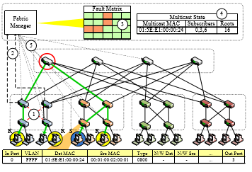
Fault Tolerant Routing - Multicast
Sender sends the packets to the designated core , and it distributes them to the receivers.
the highlighted links fail.
The failure is detected by the aggregation switches and notified to fabric manager.
The Fault matrix is updated by the Fabric Manager.
Forwarding entries are calculated for the Multicast groups.
The calculated receivers are updated with new forwarding state in appropriate tables by the Fabric Manager.

Slide 18
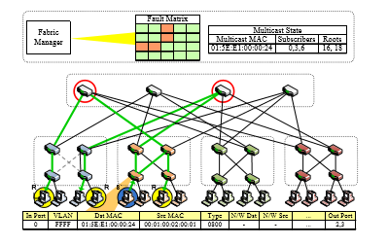
Fault Tolerant Routing - Multicast
Forwarding state for the sender after the failure recover actions

Slide 19
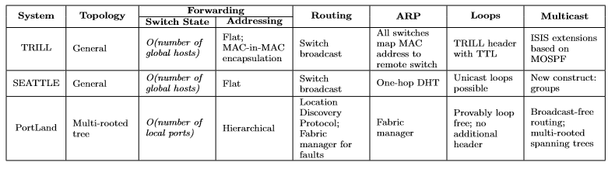
Comparison

Slide 20
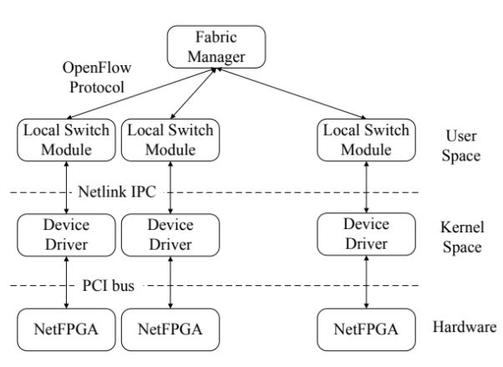
IMPLEMENTATION
20 4-port OpenFlow NetFPGA switches
32K entry TCAM + SRAM for flow entries
Software MAC rewriting
3 tiered Fat tree
16 end hosts

Slide 21
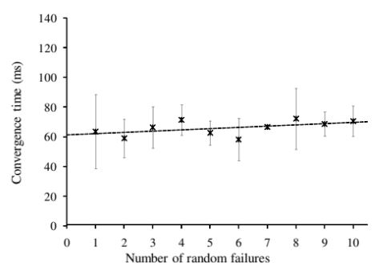
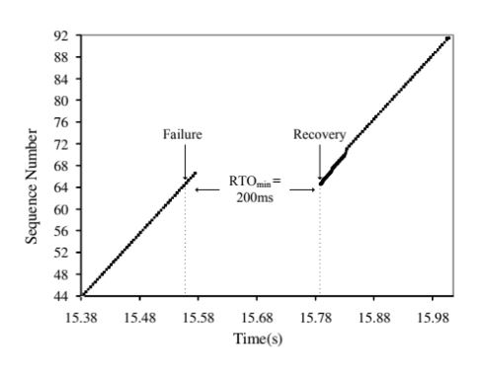
RESULT
Convergence Time With Increasing Faults
TCP Convergence

Slide 22
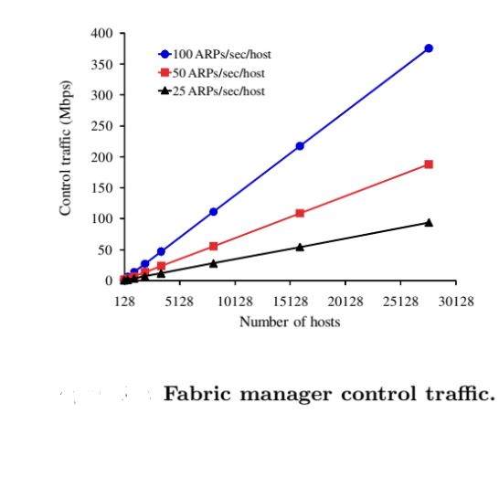
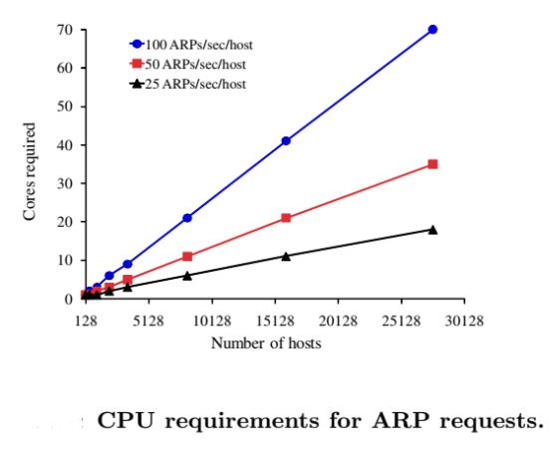
RESULT
Scalability

Slide 23
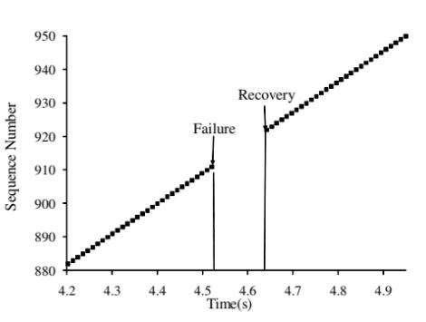
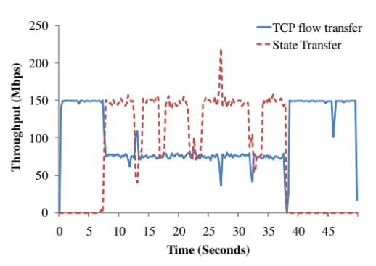
RESULT
Multicast Convergence
VM Migration

Slide 24
CONCLUSION
The goals of Portland protocol are:
Fat Tree is a suitable topology for the datacenter.
Toward zero configuration at deployment
No forwarding loops
Rapid and efficient failure detection
Native multicast support
First class support for multipath forwarding
Thus, through Portland protocol, Data Center networks can become more flexible, efficient, and fault tolerant. Data Center networks may be treated as a single plug-and-play fabric.

